Slide 1
Cat-Tastic Case Study
Moises Rodriguez (Orator on The Corn Stalks)

Slide 2
Table
Of
Contents
Introduction
Slide # 3 - Our Team, The Problem, A Solution
Slide # 4 - Users & Stakeholders
Slide # 5 - Scope & Constraints
Process
Slide # 6 - Market Research & Competitive Analysis
Slide # 7 - Examples
Slide # 8 - User Research & Interviews
Slide # 9 - Examples
Slide # 10 - Ideation
Slide # 11 - Examples
Slide # 12 - Prototyping
Slide # 13 - Examples
Slide # 14 - Affinity & Usability Testing
Slide # 15 - Examples
Slide # 16 - Iteration
Slide # 17 - Examples
Outcomes
Slide # 18 - Results
Slide # 19 - Challenges
Slide # 20 - Lessons Learned
Slide # 21 - Opportunities
Slide # 22 - Speaking of a Twist
Misc
Slide # 23 - References, Links, and Tools
Slide # 24 - End slide with thanks

Slide 3
Our Team
The Problem
A Solution
Our chosen team name was The Corn Stalks.
The group consisted of Cori Geter, Darin Dicicco, Hannah Larkins, Isabella Lawson, Jackson Krauser, Josh Knox, and self.
Our team’s main function was constant feedback and information gathering.
Across all social media platforms users collectively visit their signup landing page around 2k times a day but only 30% complete signup; New social media platform, CAT-TASTIC, wants you to create a competitive sign up flow for their up and coming mobile Apps by helping them figure out faster ways of creating an account.
Simple username/email & password, repeat password, verify email address, checkmark to save credentials.
“Sign in with..” Google, Facebook, Twitter.
User feedback if info is right versus wrong.
Incentive must be in place already, as at least 2K a day try to sign in, but 70% don’t.

Slide 4
Who are our User base versus our Stakeholders?
Our User are…
Pet owners, specifically cats.
Social media users.
Already incentivized to try and sign up for the platform, but at least 70% don’t because of most likely a design flaw.
Our Stakeholders are...
Cat-Tastic, a company looking to expand their user base and most likely bring in more revenue.
A social media platform.
Looking to boost user sign up and able to pay for a competitive sign up flow.

Slide 5
Scope
Commercial grade product, must be for the average user.
Targeted audience are cat lovers.
Targeted audience are also social media users.
Must work efficiently across all platforms (app, web, mobile browser).
Constraints
Must be naturally intuitive.
Designing a mobile app sign up flow that will encourage users to complete sign up.
Getting everything together in a specified amount of time.
Getting an ample amount of user feedback.
Whereas the focus is a sign up flow, we’re targeting specifically cat lovers who use social media, it’s a niche.

Slide 6
Market Research & Competitive Analysis
Who else has this problem? Animal lovers who want a specific platform for their specific animal species, like a mobile app for ocean fish enthusiasts.
What other solutions are out there? Generic pet social media platforms not specifically catered to cat owners, such as Instagram.
Who is using them? A very broad range of people, not just cat lovers.
How are they performing? Very well, the top 5 pet instagram profiles have millions of followers.
What are their flaws? The platform isn’t just for animals specifically.
Where are the opportunities for this solution? A platform dedicated to specifically pet/animals.

Slide 7
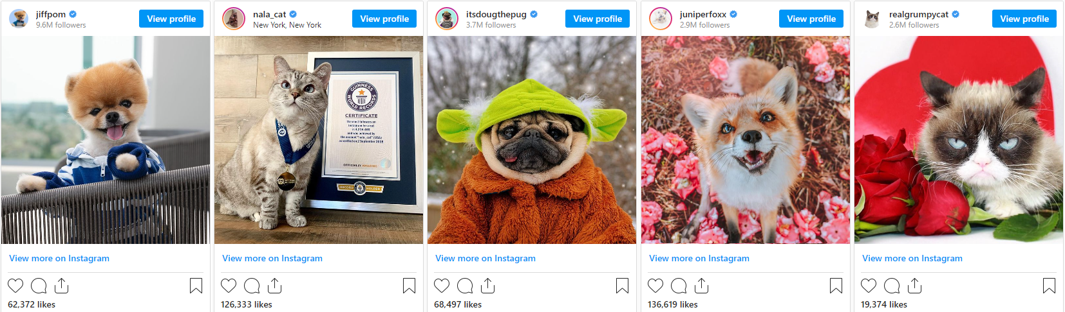
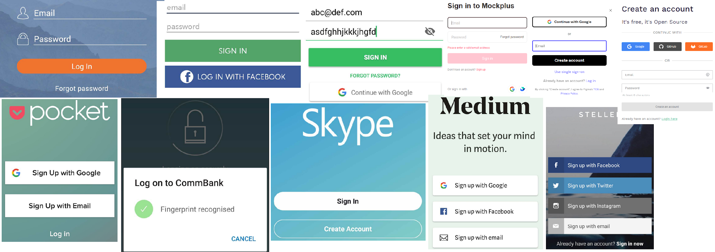
The top 5 pet centric instagram accounts.
Common and simplistic login views

Slide 8
User Research & Interviews
Who did you talk to? Primarily my team for ideas, and surveys sent out.
Why did you talk to them? For feedback on the survey itself and to move my opinions/observations in a more focused direction.
What did you learn? Getting user feedback and researching a group of people specific to a problem can be difficult and requires a bit more time.
What sort of frustrations did they have? Having to input too much information, long sign up times, having to verify their email address.
What was a highlight or striking quote from the interviews? Highlight being that a lot of the answers lined up, making it easier as a sample size.
What surprised you most? Users would typically prefer to sign up from a desktop or mobile app, but not commonly through a browser launched from a mobile device.

Slide 9
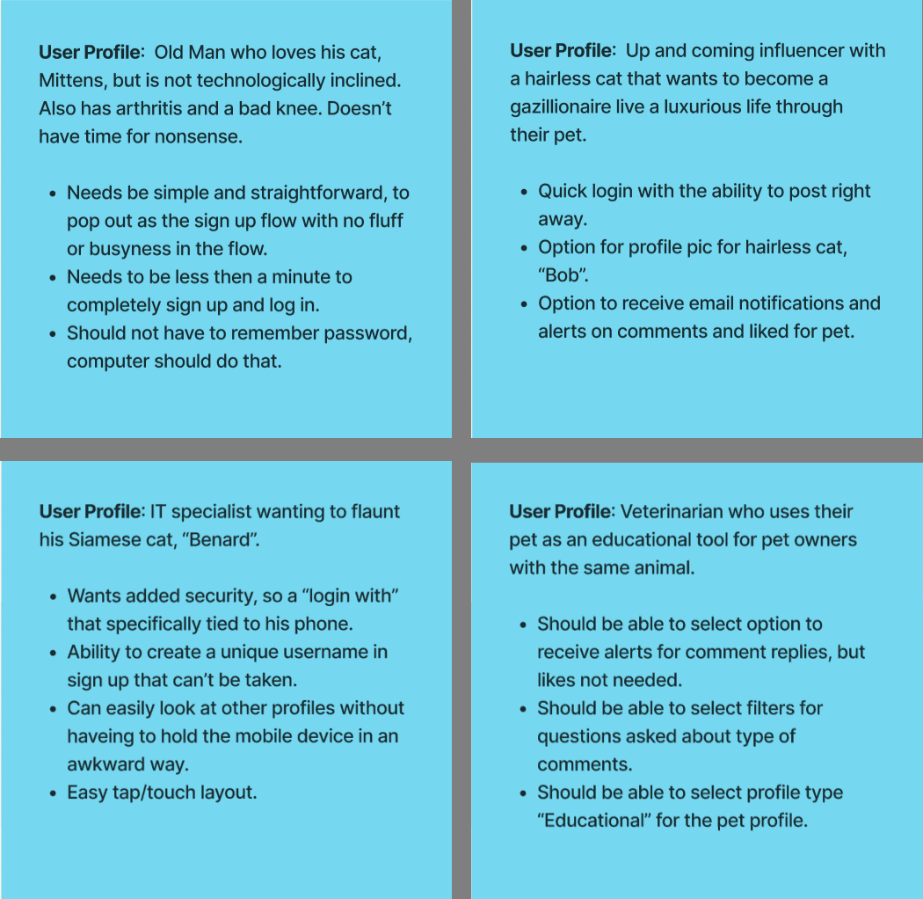
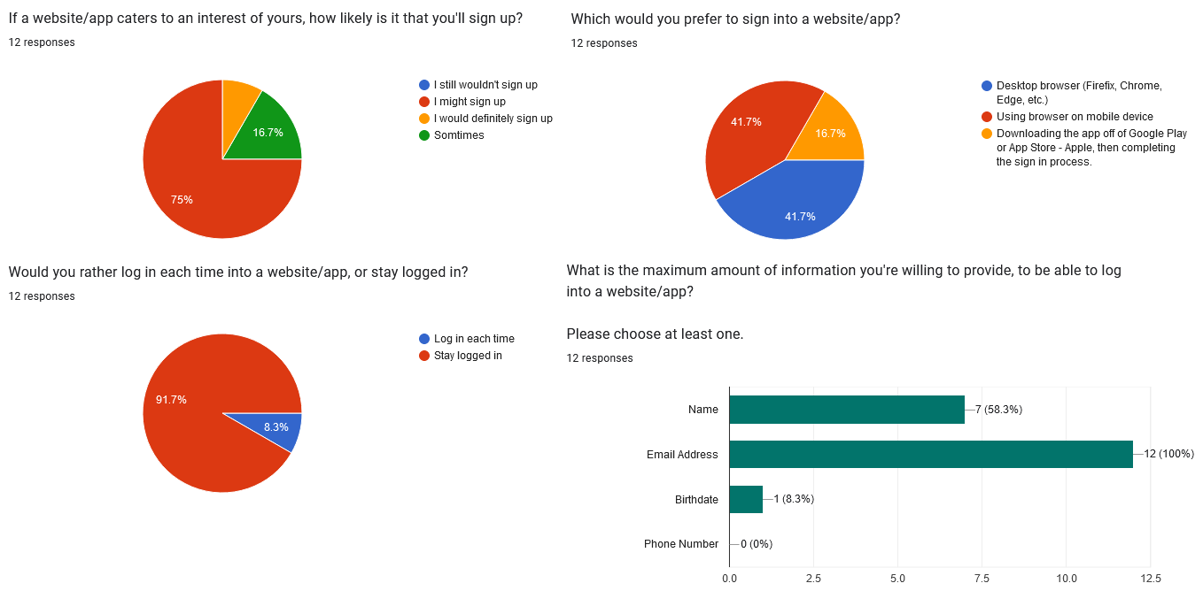
User Personas
Survey Results (samples)
Survey:
https://forms.gle/tMbYtbW17egpyHyt7
Expanded Survey results:
https://docs.google.com/spreadsheets/d/1S62QTOGfvwfuY5I_ECZ3tAK9E5KQFM4LFE0q20KjJ6Y/edit?usp=sharing

Slide 10
Ideation
What process did you follow to generate ideas? Constant list making, talking to my team through Slack, drawing, prototype after prototype, googling, figma posting, and sending each other surveys.
How many did you come up with? A couple, a simple sign up flow, with a twist.
How did you narrow them down? Talking to team, a bit of researching, and by what seemed most interesting to run with.
Which ones did you pick to move forward with? Simple sign up process with minimum requirements and a mock of what it would look like on mobile app, web, and mobile web.

Slide 11
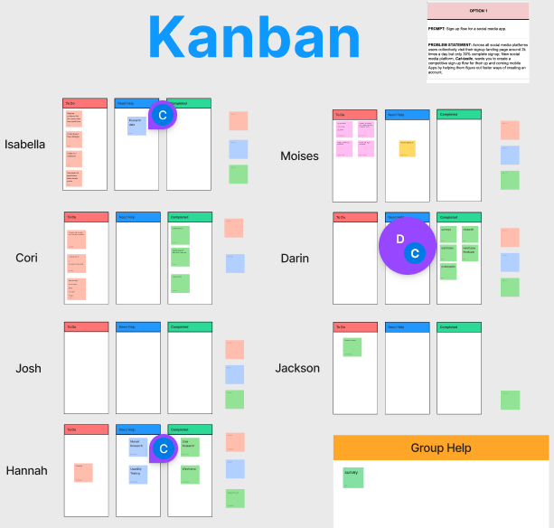
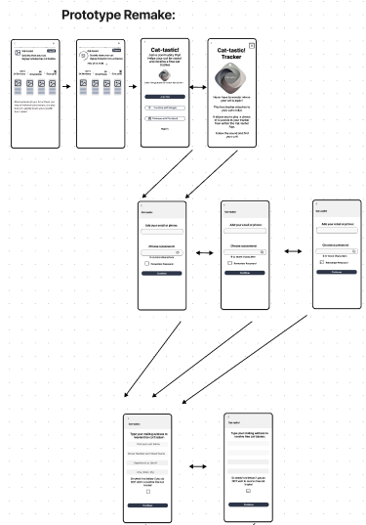
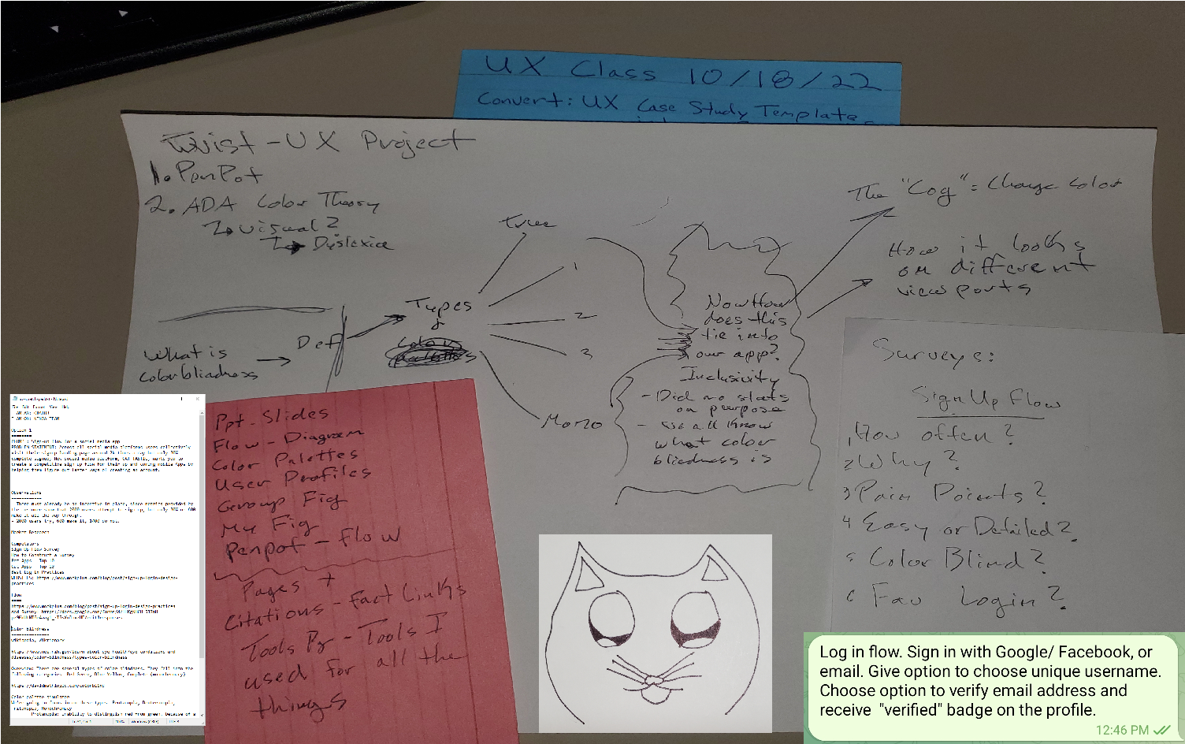
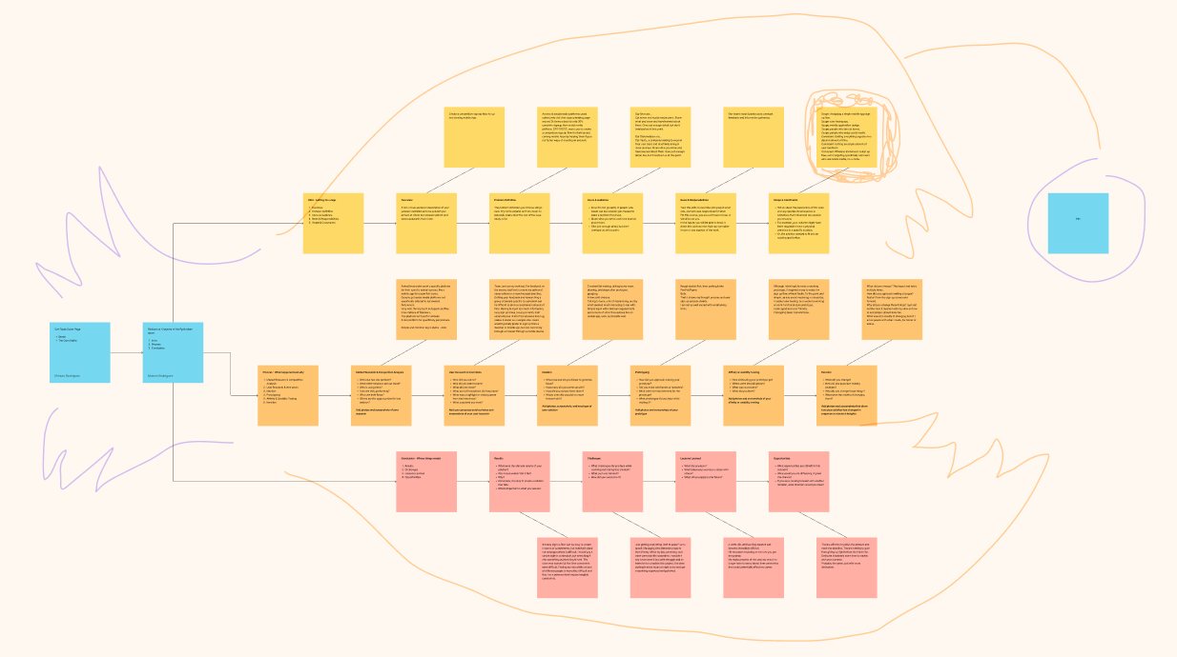
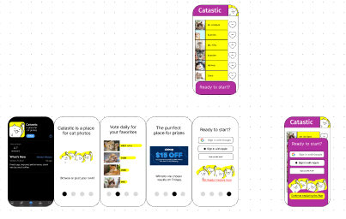
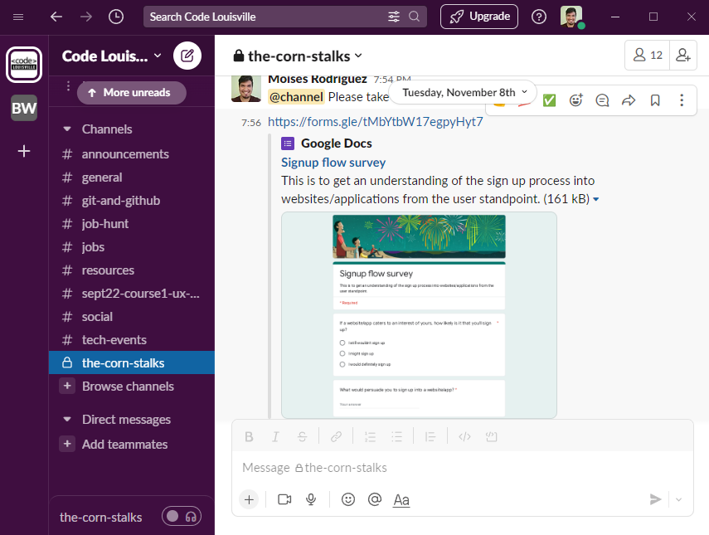
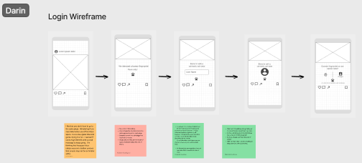
A bit of everything was done for Ideation. The group would drop everything within a Fig created by Isabella and we would give each other feedback (Kanban created by Darin). There would also be constant chat within the Slack channel. From my own end, I would make constant notes, lists, and sketches.

Slide 12
Prototyping
How did you approach making your prototype? Rough sketch first, then putting it into PenPot/Figma.
Did you make wireframes or sketches? I used a combination of both, the rough sketches for ideas and wireframes for better visualization.
What were the requirements for the prototype? That it shows my thought process and user sign up process clearly.
What challenges did you face while making it? I am not well versed with wireframing tools, there was a learning curve.

Slide 13
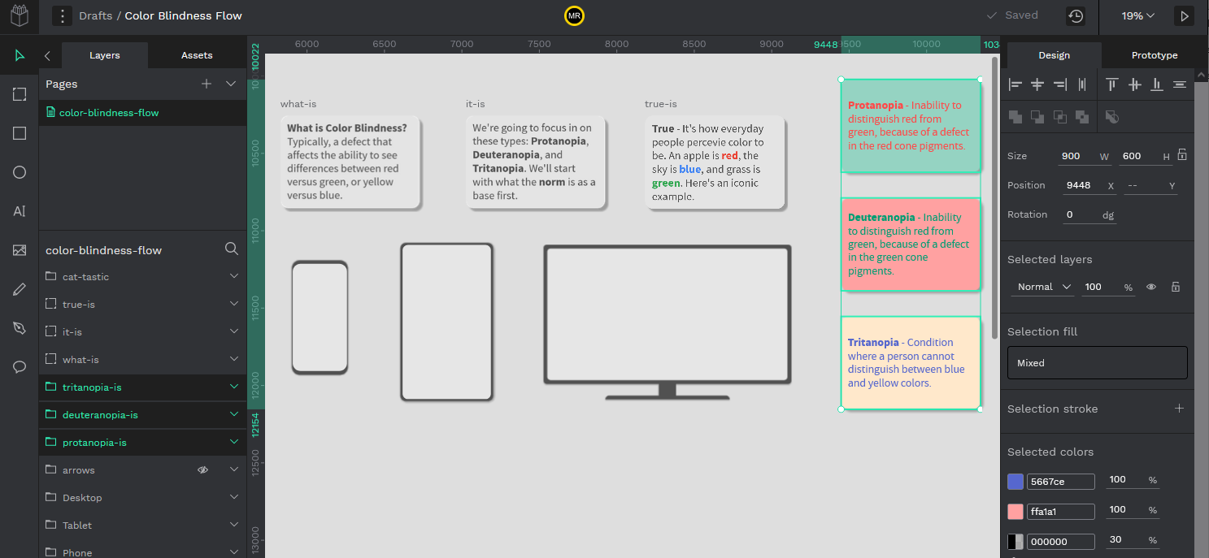
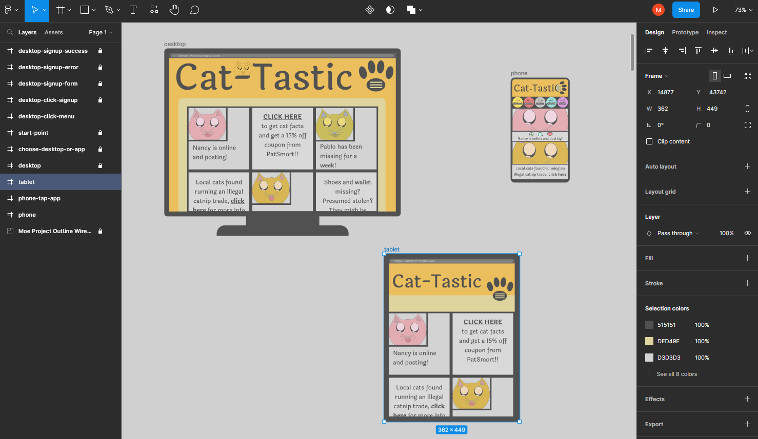
Admittedly, I believe that I might have gotten over-enthusiastic about having found a free alternative to Figma, that I took on Penpot on top of already using Figma.
Both are spectacular programs that are intuitive and always having a free alternative on hand is great for freelancing and portfolio building.

Slide 14
Affinity & Usability Testing
How did testing your prototype go? As soon as I got the hang of it, although at an entry level, it became more and more intuitive as I pushed forward. It was honestly fun.
Where were the pain points? Discerning every little nook and cranny for both Figma and Penpot. There are a lot of features, and it can become overwhelming.
What was successful? I finally got a working prototype out. It was simple, but it worked and that’s what mattered to me the most.
What did you learn? Prototyping with digital tools takes skill, time, and a whole lot of patience.

Slide 15
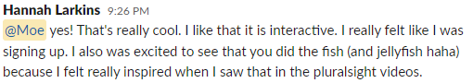
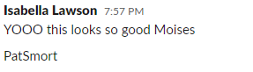
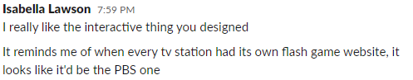
Feedback within the team
Although I didn’t have the prototype out long enough for a lot of feedback, what I did get was reassuring.

Slide 16
Iteration
What did you change? The layout and twist, many many times.
How did you approach making changes? Restart from the sign up screen and forward, there was a lot of restarting.
Why did you change those things? I just did not like how it meshed with my view on how to end project should look like.
What were the results of changing them? In my own opinion, I made something and showed that I was able to learn and grasp concepts the more I redid my prototypes. It wasn’t easy, as I am my worst critic.

Slide 17
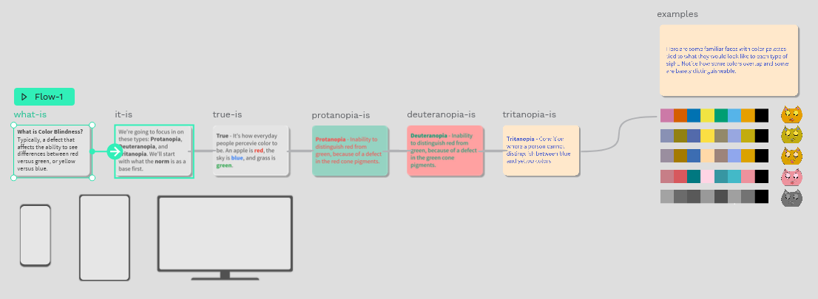
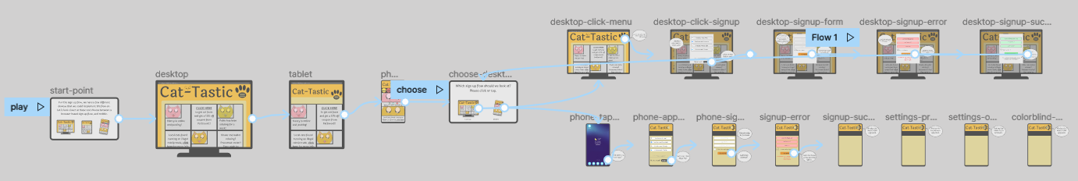
The start and end after restarting
I started in Penpot and ended up in Figma as the one difference they had was a better prototyping structure for Figma. I ran with my twist first, but came back and focused on the prompt itself, which is more important.

Slide 18
Results
What were the ultimate results of your solution? An easy sign up flow can be easy to create in terms of components, but making it stand out amongst others is difficult.
Was it successful? Did it fail? I would say it was successful.
Why? It’s a simple and very quick sign up process that’s incredibly intuitive because it’s just like any other sign up flow that a typical user would be used to.
What did I learn? Finding my role within a team of different people is incredibly difficult and that I on a personal level require tangible constraints.

Slide 19
Trials and Tribulations
What challenges did you face while creating and testing this solution? Just getting everything “pen to paper” so to speak.
What part was hardest? Balancing a heavy work and life schedule against a scholastic schedule.
How did you overcome it? I wouldn’t say I overcame it, but with struggle and an intention to complete this project, I’ve been putting in extra hours at night to try and get everything organized and polished. I did not want to fail. So I put the time in.

Slide 20
Lessons Learned
What did you learn? A work, life, and learning balance can become incredibly difficult and that the focus of any problem can be as simple or hard as we make it.
What takeaways would you share with others? Hit the project running as soon as you get the prompt.
What will you apply in the future? My major projects of the year are over, I no longer have to worry about time constraints that could potentially affect my career.

Slide 21
Opportunities
What opportunities are still left in this solution? I’ve learned new things and taken one more step forward towards a UI/UX career. I’m going to continue to polish my project, even after it’s been turned in.
What would you do differently, if given the chance? Dedicate absolutely more time to market and user research.
If you were moving forward with another iteration, what direction would you take? Probably the same, just with more dedication, and with the twist I originally intended to do.

Slide 22
Speaking of a Twist.
What opportunities are still left in this solution? I’ve learned new things and taken one more step forward towards a UI/UX career. I’m going to continue to polish my project, even after it’s been turned in.
What would you do differently, if given the chance? Dedicate absolutely more time to market and user research.
If you were moving forward with another iteration, what direction would you take? Probably the same, just with more dedication, and with the twist I originally intended to do.

Slide 23
References, Links, and Tools
Best Design Practices:
https://www.mockplus.com/blog/post/sign-up-login-design-practices
Government overview of color blindness:
https://www.nei.nih.gov/learn-about-eye-health/eye-conditions-and-diseases/color-blindness/types-color-blindness
Color palette simulator:
https://davidmathlogic.com/colorblind
Top pet related apps
https://www.lifewire.com/pet-social-networks-3486561
Most followed instagram accounts
https://www.lifestyleasia.com/kl/culture/entertainment/most-followed-pet-instagram-accounts
Link to section in GROUP Fig.
Link to specific design/prototype Fig.
Link to Penpot/Coloblindness prototype.
Link to survey sent to users.
Link to survey results.
Tools used: Krita, Photopea, Snapseed, Notepad++, Penpot, Figma, LibreOffice, PowerPoint, Google Slides, Google Forms, Snipping Tool.

Slide 24
Fin.
A heartfelt thanks to The Corn Stalks, my teammates.
Also big thanks to the mentors who took time to volunteer their knowledge, perspective, and time.

